Slide 1
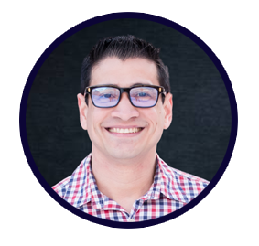
Current Trends in Quantum Computing
Ricardo Prins
QPower
Microsoft Student Partner, USA

Slide 2
Microsoft and Quantum
What are they doing?
(also, can I do that?)

Slide 3
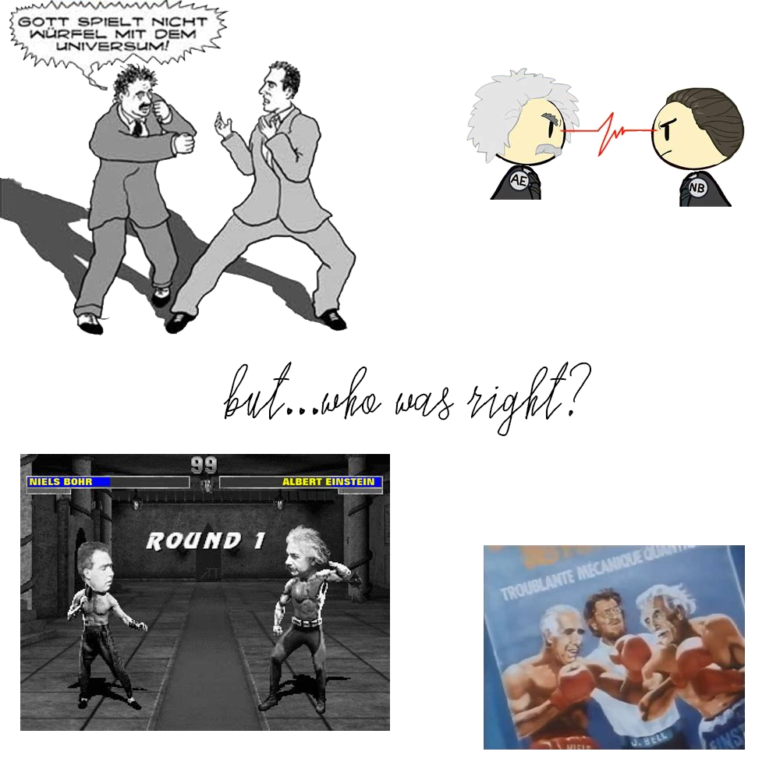

Slide 4
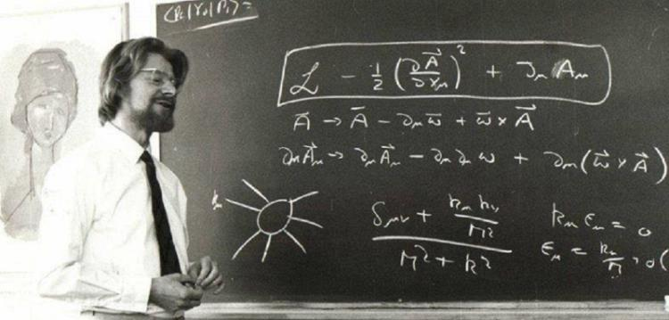
John Bell – the hippie physician who proved Einstein wrong!

Slide 5
Quantum vs. Classical Computing

Slide 6
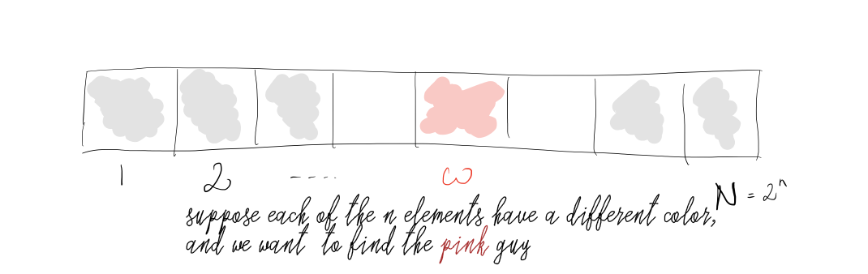
Grover
namespace Microsoft.Quantum.Samples.SimpleGrover {
open Microsoft.Quantum.Convert;
open Microsoft.Quantum.Math;
open Microsoft.Quantum.Arrays;
open Microsoft.Quantum.Measurement;
@EntryPoint()
operation SearchForMarkedInput(nQubits : Int) : Result[] {
using (qubits = Qubit[nQubits]) {
// Initialize a uniform superposition over all possible inputs.
PrepareUniform(qubits);
for (idxIteration in 0..NIterations(nQubits) - 1) {
ReflectAboutMarked(qubits);
ReflectAboutUniform(qubits);
}
// Measure and return the answer.
return ForEach(MResetZ, qubits);
}
}
function NIterations(nQubits : Int) : Int {
let nItems = 1 <<< nQubits; // 2^numQubits
// compute number of iterations:
let angle = ArcSin(1. / Sqrt(IntAsDouble(nItems)));
let nIterations = Round(0.25 * PI() / angle - 0.5);
return nIterations;
}

Slide 7
Now what…?

Slide 8
If I were forced to sum up in one sentence what the Copenhagen interpretation says to me, it would be “Shut up and calculate!” But I won’t shut up. I would rather celebrate the strangeness of quantum theory than deny it, because I believe it still has interesting things to teach us about how certain powerful but flawed verbal and mental tools we once took for granted continue to infect our thinking in subtly hidden ways. I don’t think anybody, even Bohr, has done an adequate job of extracting these lessons.
(Mermin, What’s Wrong with this Pillow, Physics Today, 1989)

Slide 9
Thank you!
ricardoprins@studentpartner.com
QPower – bit.ly/qpower_msp
www.iamprins.com
LinkedIn: linkedin.com/in/ricprins | Twitter:@thericardoprins

